Slide 1
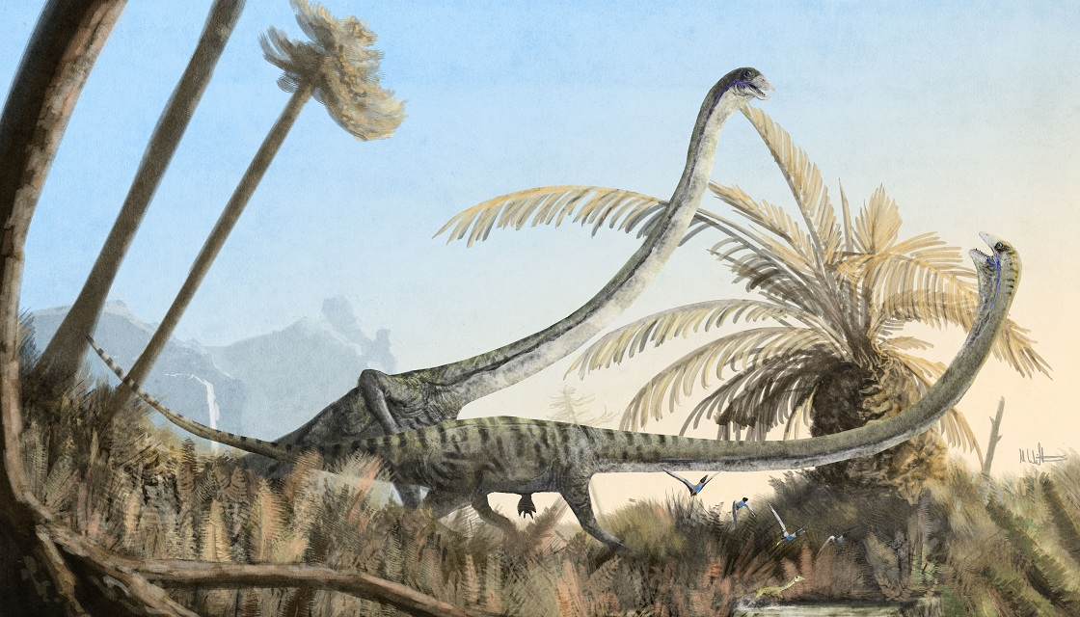
Tanystropheus “long + hinged”
Adrian Obermühlner

Slide 2
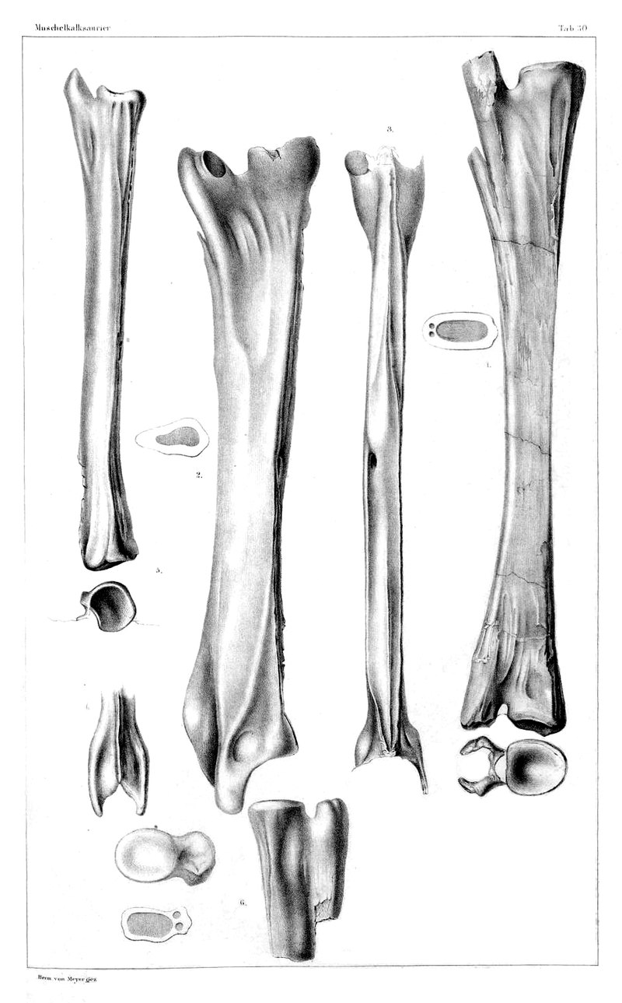
Fossile findings
1852 Von Meyer
Polish and German
Notes:
Arthur Lakes finder des ersten Stegosaurus, er glaubte es seien Teile einer risen Schildkröte. Deswegen auch der Name “Roofed Lizard”.
Vermischte mehrere Dinosaurier beim ersten Stego
Platten Theorie:
Auf dem Rücken wie eine Schildkröte (Marh’s theorie)
Single Row
Double row
Double row, abwechselnd

Slide 3
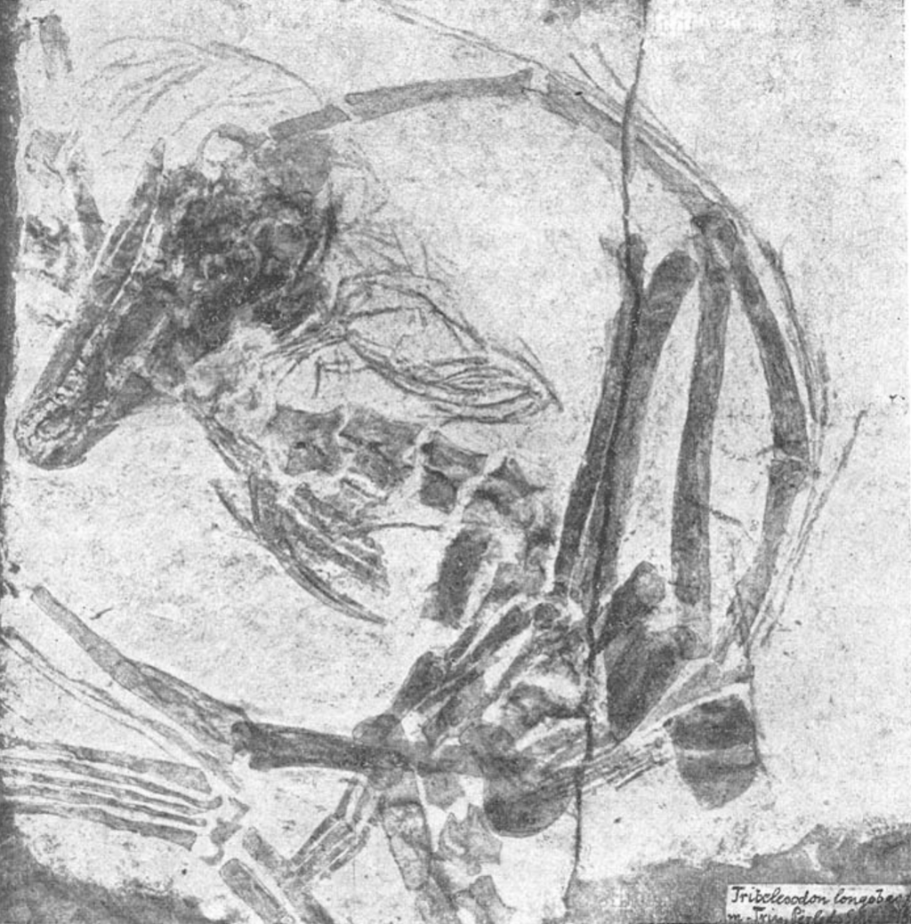
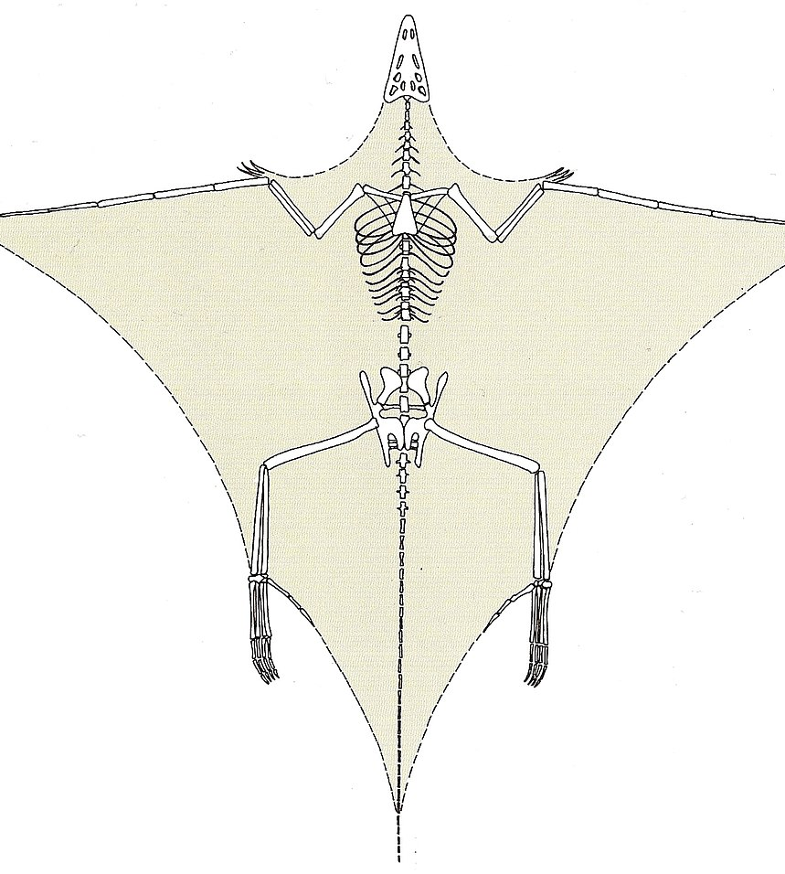

Monte San Giorgio
1886 Tribelesodon longobardicus (holotype)
Unvieristy Zurich 1920 -1930 many more
Ellongated finger bones -> neck verterbrae
Notes:
40 years after discovery, non-flying reptile
A specimen from 1929 is defined as the neotype
Milano, Uni Zurich and Lugano
Until today they are digging up Tanystropheuses there

Slide 4



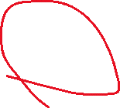
Notes:
Europe, Asia and Northamerica in the Triassic Period
242 to 235 million years ago

Slide 5
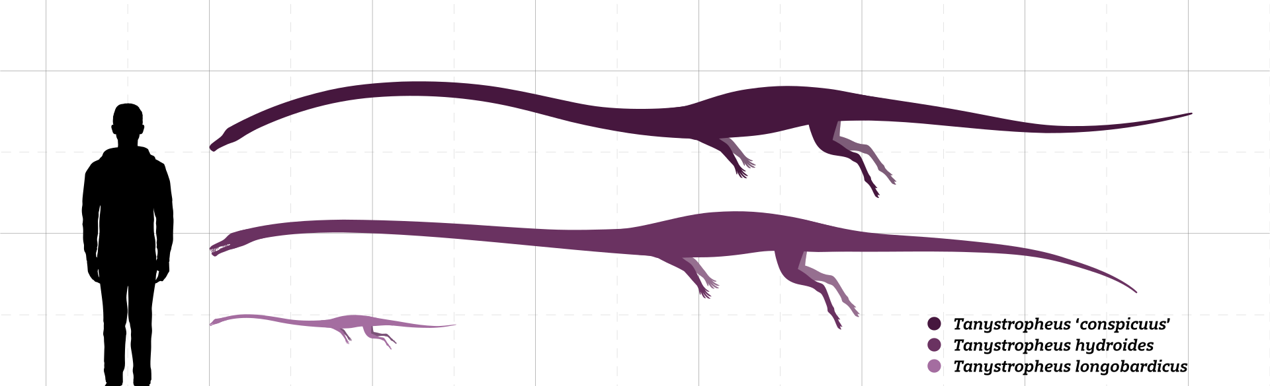
Anatomy
One of the longest known non-archosauriform archosauromorphs
Neck is three times of the body length
32.9kg – 74.8kg
Notes:
Archosauriforms include archosaurs, which encompass modern birds and crocodilians as well extinct dinosaurs and pterosaurs

Slide 6
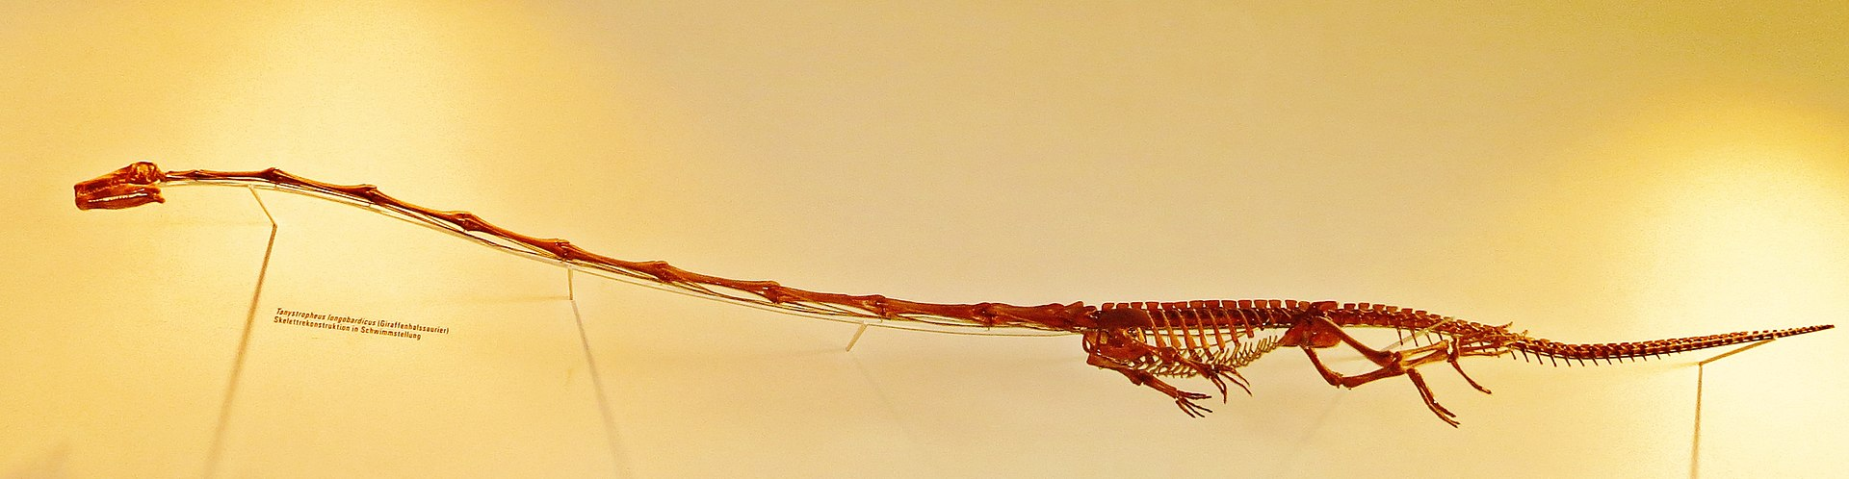
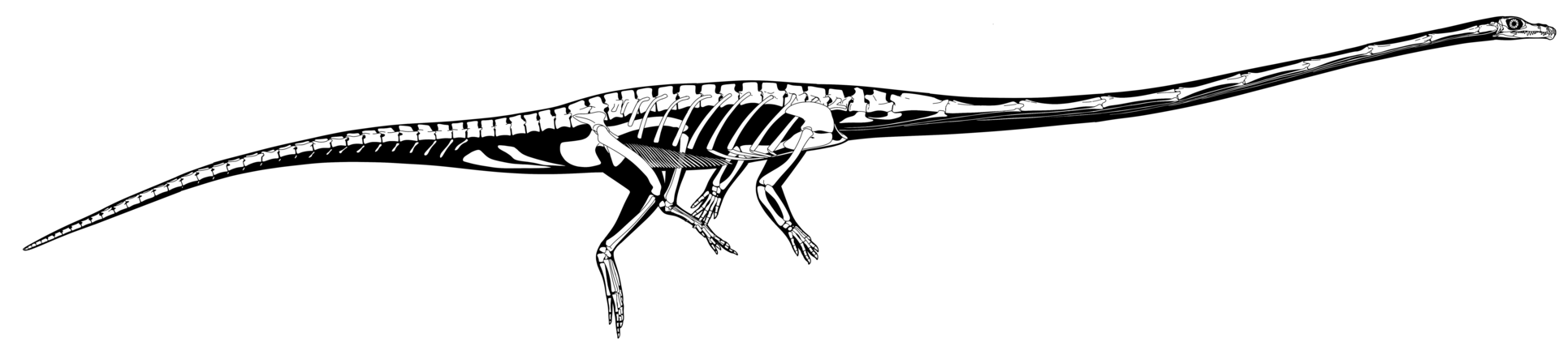

Slide 7
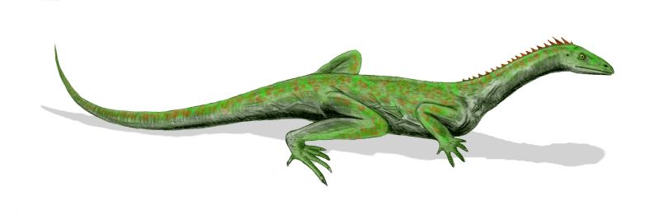
Classification
Closely related to Marcocnems

Slide 8
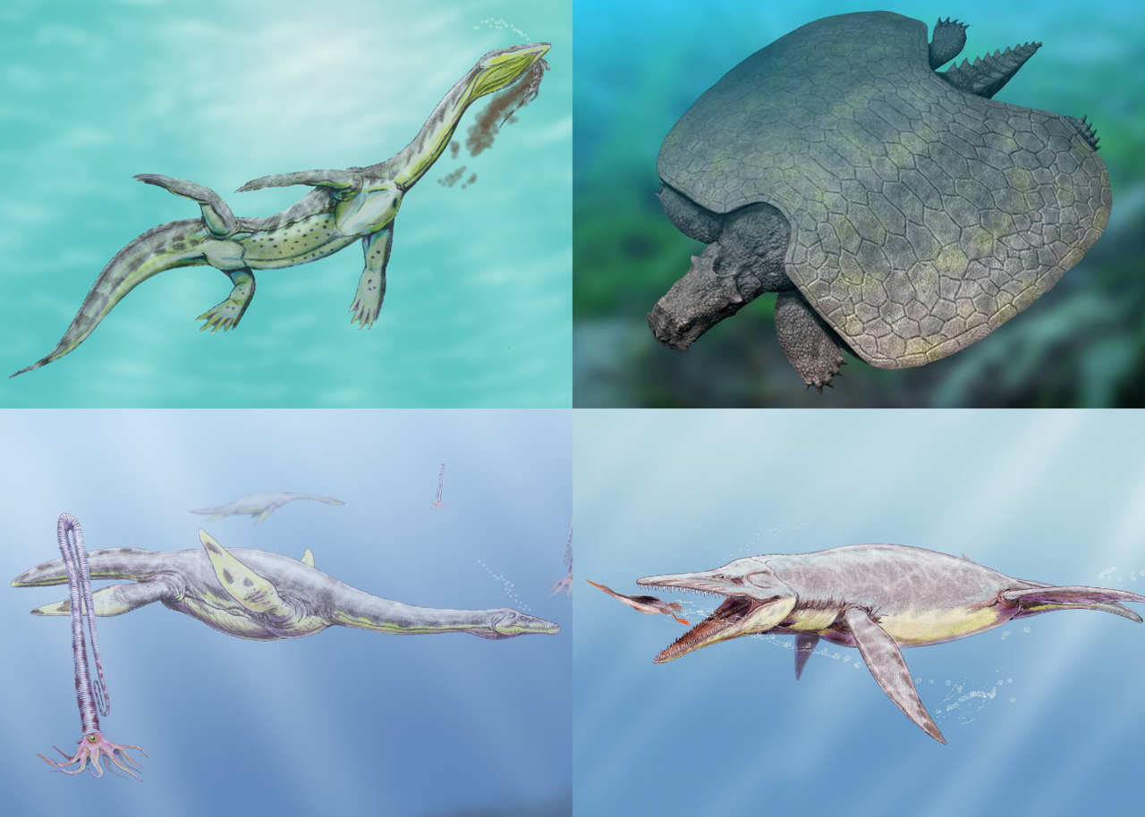
Classification
Not to: Sauroptercgians such as
Plesiosaurus
Nothosaurus
Araescelis
Notes:
Still everything debated until today, lots of theories exist

Slide 9
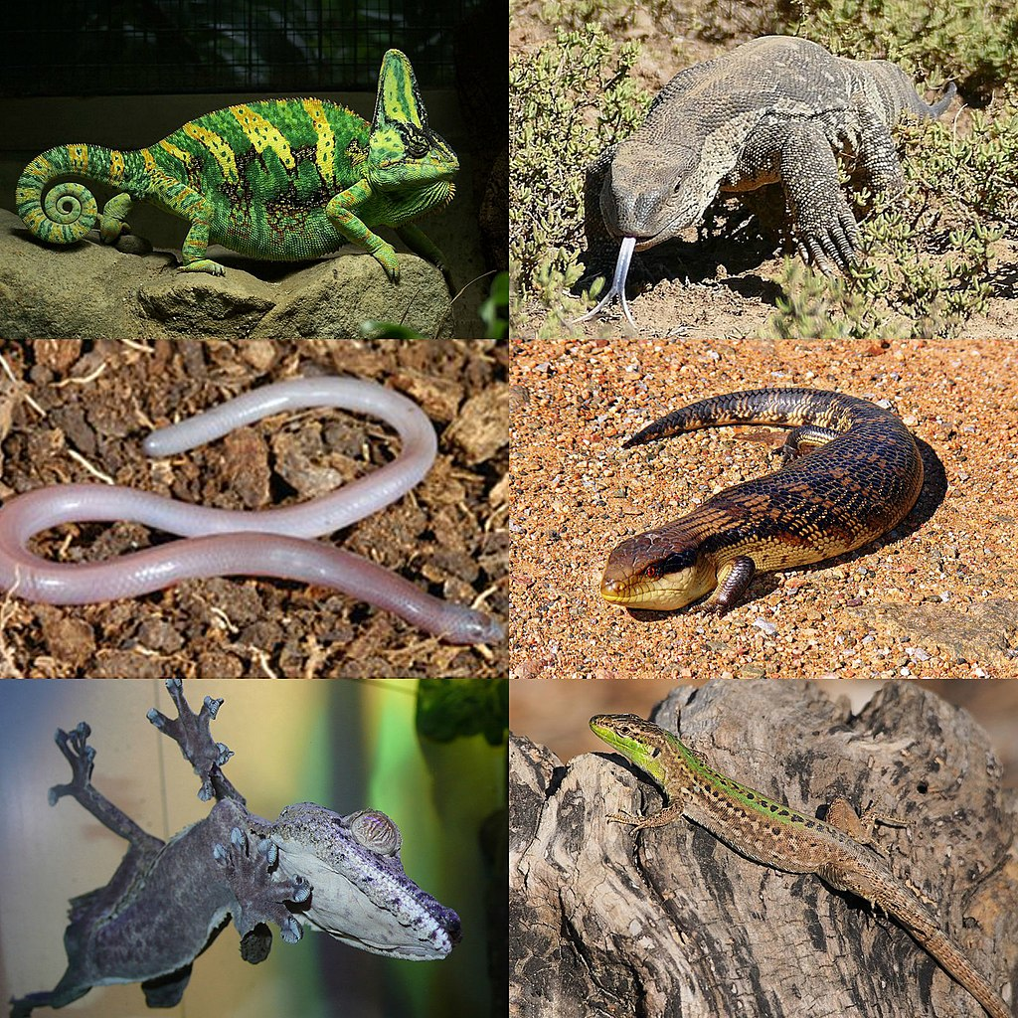
Classification
Theory of lacertilians

Slide 10
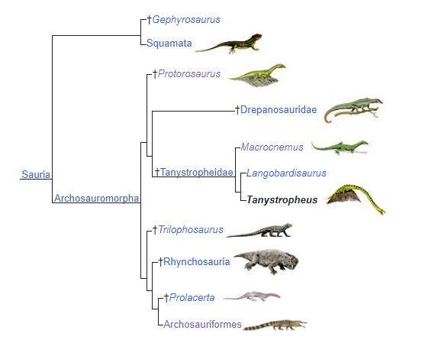
Taxanomie

